Slide 1


DS 1.1: Data Analysis & Visualization
The Normal Distribution!
Notes:
Title Slide

Slide 2
Data Science Process
Ask a
QUESTION
EXPLORE
data
GET
data
MODEL & PREDICT
data
CONVEY &
VISUALIZE results
Notes:
Review of DS Process
Today, we cover ASKING QUESTIONS and EXPLORING DATA from a conceptual standpoint as we introduce some statistical concepts to the student.

Slide 3





KEY LANGUAGES
DATA ANALYSIS
VISUALIZATION TOOLS
seaborn
ESSENTIAL RESOURCES
Notes:
Review of DS Toolkit
From the EDA tutorial so far, students should have learned a little bit of MatPlotLib up to this point.

Slide 4

Notes:
Quick 15-20 min HW review: students partner up and share progress and blockers they had on conditional probability and Aakash’s HW with the App Store EDA tutorial.

Slide 5
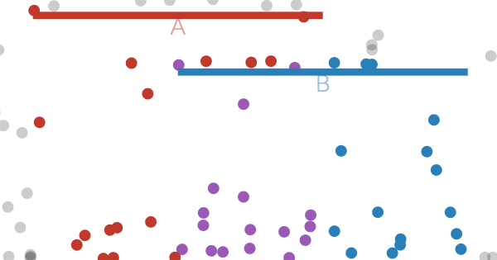
Click here!
Notes:
Quick Review (<15 min) of Conditional Probability

Slide 6
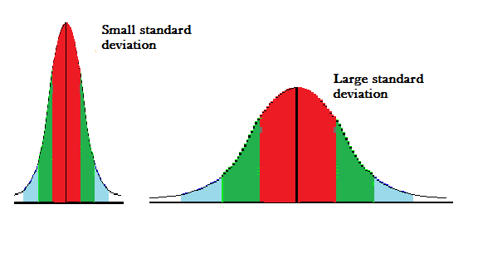
Notes:
Standard Deviation

Slide 7
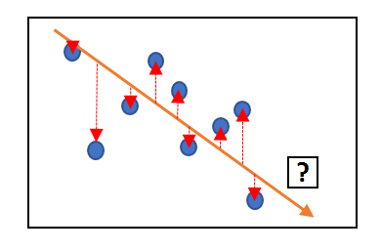
Notes:
Variance and Relationship with Std. Dev.

Slide 8
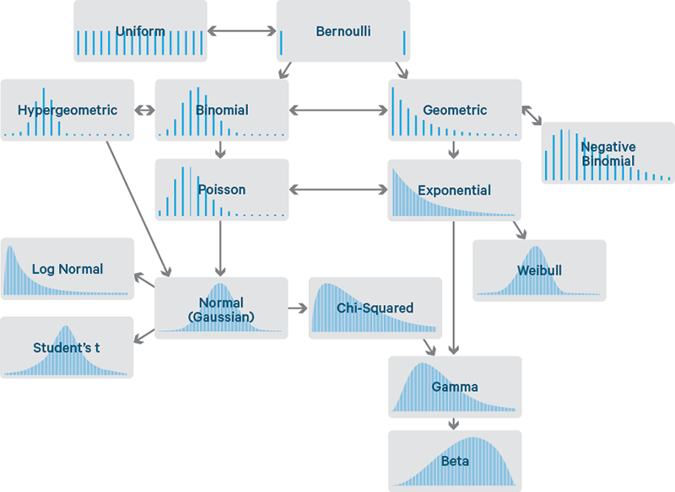
Notes:
Many Different Types of Distributions

Slide 9
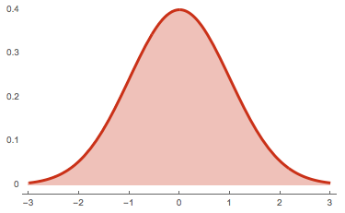
Notes:
The Normal Distribution

Slide 10
Notes:
Quick 15-20 min HW review: students partner up and share progress and blockers they had on conditional probability and Aakash’s HW with the App Store EDA tutorial.

Slide 11
M = M = M
Notes:
Mean = Median = Mode

Slide 12
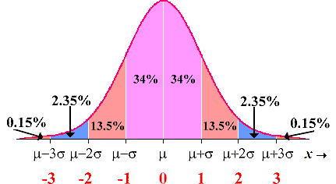
Notes:
68-95-99.7 Rule

Slide 13
Notes:
Quick 15-20 min HW review: students partner up and share progress and blockers they had on conditional probability and Aakash’s HW with the App Store EDA tutorial.

Slide 14
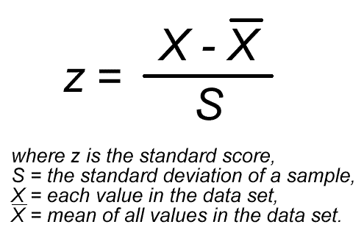
Z-Score!
Notes:
Z-Scores and Putting It All Together

Slide 15
Notes:
Quick 15-20 min HW review: students partner up and share progress and blockers they had on conditional probability and Aakash’s HW with the App Store EDA tutorial.

Slide 16
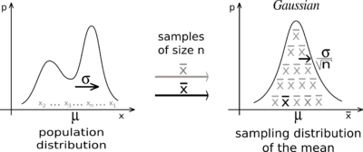
The Central Limit Theorem

Slide 17
Notes:
Quick 15-20 min HW review: students partner up and share progress and blockers they had on conditional probability and Aakash’s HW with the App Store EDA tutorial.

